Slide 1
Farmer’s Friend(FOF) Domain Bucket : Agriculture and Rural Development Category : Software Ministry / Organization Name : CDK Global Problem Statement Number : RA28 Problem Statement :Crop Guidance and Farmers Friend Team Name : Code Break Team Leader Name : PRATHIK.N College Code : U-0725
Idea/approach details
Agriculture is the major sector of the Indian economy contributing to one-third of Indian GDP and farmers are the backbones of society. Even though it yields employment to 60% of the population there is some dilemma faced by the farmers due to inadequate knowledge of modern agriculture practices. This holds them from deploying modern technical resources.
The FOF focuses on providing the farmer point-to-point guidance throughout the farming process. Crop suggestion is done on the basis of season, weather conditions and requirements/demands in the market. It guides the farmer to take precautionary measures during unduly rains. Red alerts are notified during the pest attack. It easies the purchase of agricultural tools from the online market and also automates the banking process thereby helps in managing the expenses. Crop price is estimated based on the market rate. A Chatbot assists the farmer with their queries. Revenue for the company is generated from ads of the agricultural tools and bringing out premium features after one harvest.

Slide 2
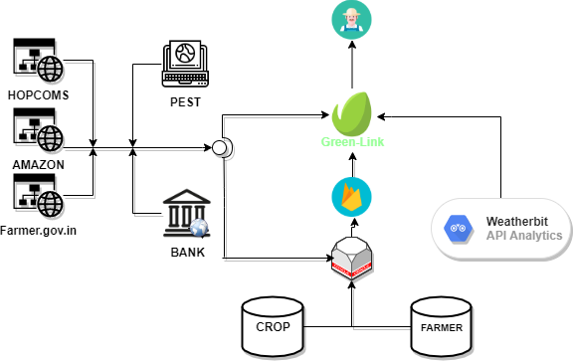
Idea / Approach details
BLOCK DIAGRAM

Slide 3

Idea / Approach details
dasdasdasdasdasdasasddsa
asdasdasdasdasda

Slide 4
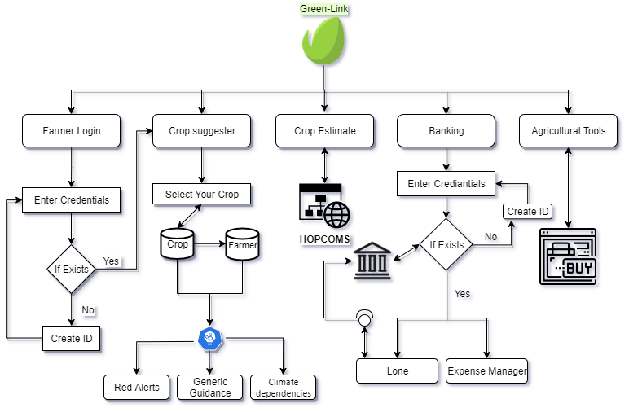
Idea / Approach details
FLOW CHART

Slide 5
Idea / Approach details
Technology stack
Android studio.
Firebase, oracle.
Natural language processing.
JavaScript , SQL , flutter.
Use Case
Designed for Farmer.
Home gardening.
Organic farms.
Dependencies / Show stopper
Accuracy of global weather modals.
Poor online network for Cooperative banks.
Poor network connectivity.

